Slide 1

Politecnico di Milano
A.A. 2015-2016
Software Engineering 2 project: MyTaxiService
RASD
(Requirements Analysis and Specification Document)
Alessandro Pozzi (matr. 852358), Marco Romani (matr. 852361)

Slide 2
Definitions
Customer –Registered user that may demand a taxi ride.
Standard customer – Person who is not using MTS’s applications but may still require a ride with the “traditional” method.
Taxi Driver – Employee of the taxi service.
Taxi zones –2km² areas in which the city’s territory is divided. Each taxi queue is associated to a single taxi zone and vice versa.

Slide 3
Definitions
Request – Customer’s demand to be picked up by a taxi, sent using the web or mobile application.
Reservation – Ride that has been reserved by a customer using the web or mobile application. It becomes automatically a request 10 minutes before the established time.

Slide 4
Definitions
Taxi driver availability – The status of a taxi driver.
In detail, these are the 2 possible status of a taxi driver:
Available – When the driver has no customer to pick up and it’s ready to accept new requests.
Busy – When the driver is taking care of a request or of a standard customer. Note that the taxi driver is considered “busy” even if he hasn’t pick up the customer yet, but has only accepted his request.

Slide 5
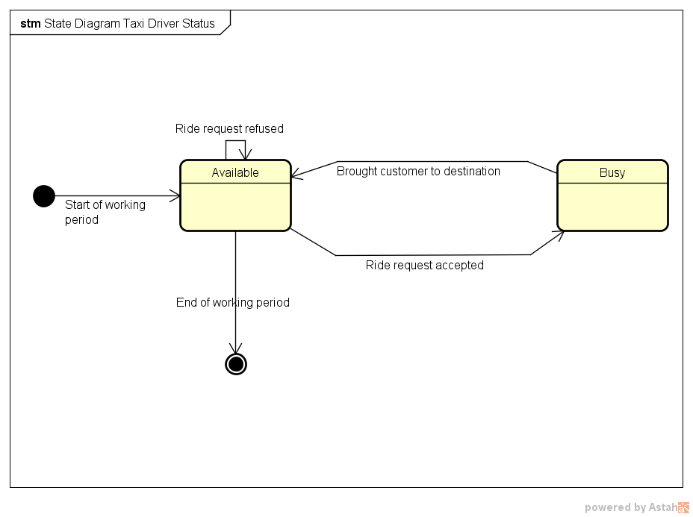
In this case ‘’ride request’’ is meant to be any ride request, possibly a request from a standard customer or maybe a reservation which is seen as a request from the driver’s point of view.

Slide 6
Definitions
Customer and taxi driver pair – Sometimes taxi drivers and customers are said to be “paired”: this happens only after a requests or 10 minutes before a reservation, when the system chooses a taxi driver to serve the customer. Basically it corresponds to the ride status Assigned. This association ends when the taxi drops the customer to the requested destination.

Slide 7
Definitions
In detail, these are the possible status of a taxi ride:
NotAssigned – This is the default status of a taxi ride requested by customers. It simply means that the request (or reservation) has been accepted by the system but nothing else has been done yet.
Assigned – Appears when the system has assigned a taxi to the customer.
Completed – When the taxi driver has brought the customer to destination and has declared himself “Available”.
Annulled – When the customer has deleted the request (or reservation).

Slide 8
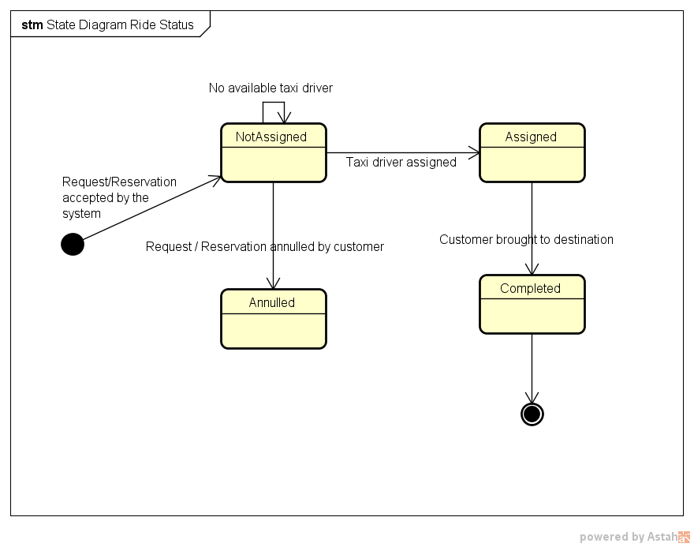
In this case ‘’ride’’ means only rides or reservations made by registered customers.

Slide 9
Domain Assumptions
Requests and reservations can be cancelled if and only if no taxi have been assigned to the customer.
Customers and taxi drivers access to the same mobile app. The available functions will depend by the login phase, which determines the type of user connected.
A taxi driver account cannot be used as a customer account, and vice versa. This means that if a taxi driver wants to access the customer’s services, he will need to create a customer account.
Taxi drivers can log into the web application with theirs driver’s account but cannot access to the customers’ service. The only available function will be the modification of some account information.

Slide 10
Domain Assumptions
Taxi drivers will manually update their status (available or busy) with the mobile app every time they pick up or drop off standard customers. On the contrary, when drivers accept a ride request by MTS customers, the “busy” status will be automatically set up by the system. Anyway, the “available” status must still be selected manually after the customer has been taken to destination.
Taxi drivers have a fixed amount of time of 1 minute to answer a ride request. If the answer is not received, the system will consider the request as refused and act accordingly.
Customers are allowed to perform unlimited taxi reservations. However, due to the fact that overlaps between two reservations are not predictable, the system will cancel any impracticable reservation identified at runtime.

Slide 11
Domain Assumptions
Customers are not allowed to request a taxi ride if any other request made by the same account has not been fulfilled yet.
If and only if a taxi zone does not have any taxi available to answer a request, the system will search for an available taxi in adjoining zones. Worst case scenario: if there are no taxi available in the adjoined zones, the costumer should be notified and put in hold. During this period of time the costumer should be allowed to cancel the request.
Taxis are assumed to be well distributed in the city’s taxi zones. This means that taxi zones never happen to be completely empty and the situation in which no taxi drivers are present, either available or busy, cannot occur.

Slide 12
Domain Assumptions
Payment and specific duties related to the taxi service are not considered and managed by the application. MyTaxiService is meant to be only an interface between customers and taxi drivers.
The web and mobile registration is intended for customers only. Taxi drivers’ account are created by an administrator when they are hired by the taxi company. Taxi drivers will then receive their username and temporary password, which they will be able to change once logged in the application.
The system will not accept reservation whose date is latter than a year in respect to the submission date.

Slide 13
Overall Description
Product perspective
The applications to be developed is not completely independent and self-contained:
it will rely mainly on the GPS system in order to retrieve the position of all its taxis.
possible future integrations and extensions by releasing a set of APIs so that MTS may be exploited by other companies and developers and integrated with similar services.
APIs will also provide an easier development of additional functions, like taxi sharing or a SMS-based reservation system.

Slide 14
Overall Description
User characteristics
Two types of users: taxi drivers and customers.
No particular skills or information technology knowledge are required, since the application will be easy to use and accessible by any mobile phone or computer that have access to internet.

Slide 15
Overall Description
Future possible implementations
The implementation of a taxi sharing service, which allows customers to share their ride with other users in order to decrease the cost of the ride.
The implementation of a SMS system, which allows users to request or reserve a ride by sending a SMS. SMS syntax rules may be available online or may be sent by request with a SMS. This function may extend the service to those who does not have always access to an internet connection, like tourists.

Slide 16
Overall Description
A function that estimates how much time a ride will take and how much it will cost. This function may be accessible even without requesting a ride.
An improved taxi management system, which redistributes available taxis moving them from high density areas to low density areas.
The possibility to show the GPS position of the customer’s taxi on an interactive map.

